Slide 1


Image Processing Detection of road signs
Gustav Willig (197332) | Daniel Husfeldt (197349) | Heilbronn University
Figure (Gillich, 2016)
Notes:
Good morning everyone my name is Gustav Willig and this is Daniel Husfeldt , and together we would like to welcome you here today.

Slide 2
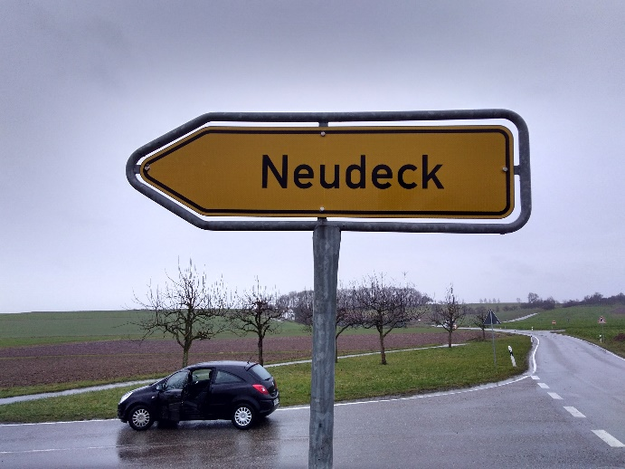
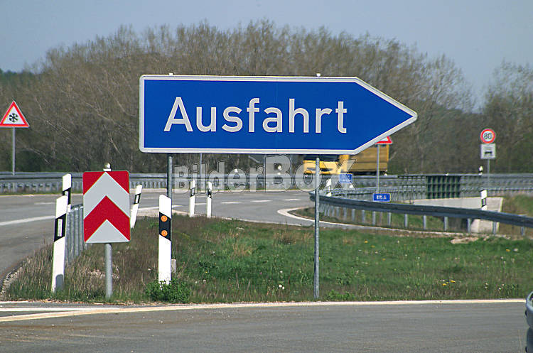
Contents
Project goals and tasks
Image pre-processing
Object recognition and classification
Letter recognition and classification
Results
Challenges
Discussion
Figure (Wodicka, 2002)
Notes:
In todays presentation we would like to give overview about our image processing project
I start by telling you a bit about the project goals Tasks
Then I’d just like to give you some background information about image pre-processing
After that we will take a look at methods we use for object and letter recognition and classifiation
What brings us to the last section of the present and discussion.
There'll be time at the end of the presentation to answer all of your questions
Ok lets start

Slide 3



Project goal
„Detection of road signs“
Different types of road signs
Figure (Onlinestreet, no date)
„arrow signpost“
„town sign“
„in town sign“
Figure (Wodicka, 2002)
„highway sign“
Notes:
The project allows us student to apply the high level of theory we learned during the lesion of image processing to build a real-world application.
The goal of our project was to detect different kinds of road signs for an example town signs, arrow signpost, in town sign or motorway signs.

Slide 4
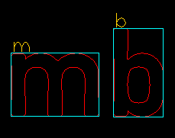


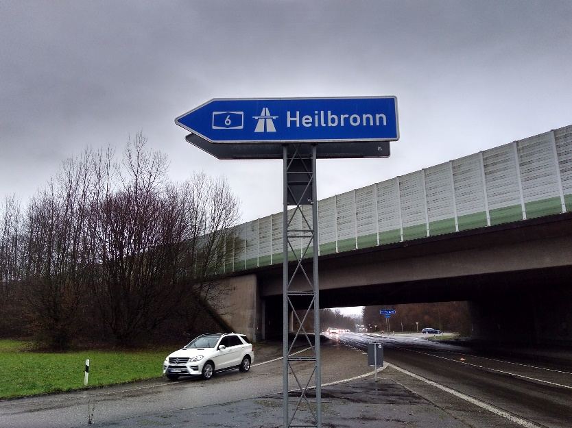
Project tasks
Road signs | Letters
Reconize and extract road signs Classificate them as In-town signs Signs on a country road Highway signs | Recognize and extract letters Classificate letters
Optional goal: Using pictures of road signs in confusing and real traffic situations
Notes:
The project consisted of two main tasks.
The first task was to recognize and extract the road sign from a given image.
A subtask of that was to identify the kind of the road sign as an in-town sign, a sign on a country road or a highways sign
The second task was to recognize and extract the letters from the identified sign and to classifice them
An optional goal of the project was to use picture which we took from complex and confusing real traffic situations

Slide 5
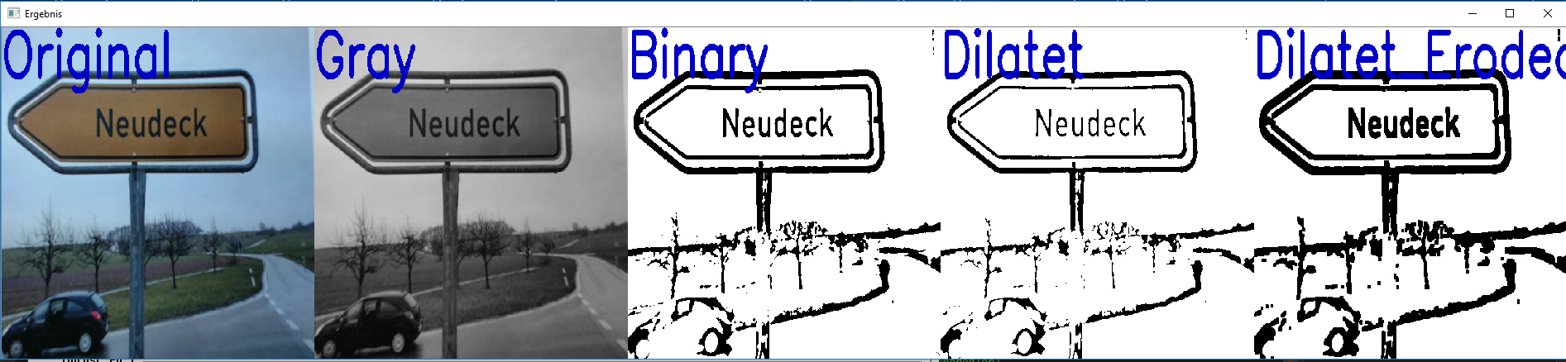
Image pre-processing
Gray image
Gaussian filter
Binarization (adaptive threshold/ Otsu)
Morphological filter (erosion and dilation)
Notes:
We followed the following steps in order to pre-process the impage.
The first step was to convert the image to an grayscal
The second step was to use a gaussian filter in order to reduce the amount of measurement error
After that we used an adaptive threshold or the otsu-methode to convert the grayscal image to a binary image
Then we used morphological filter to dilate and erode the image.

Slide 6
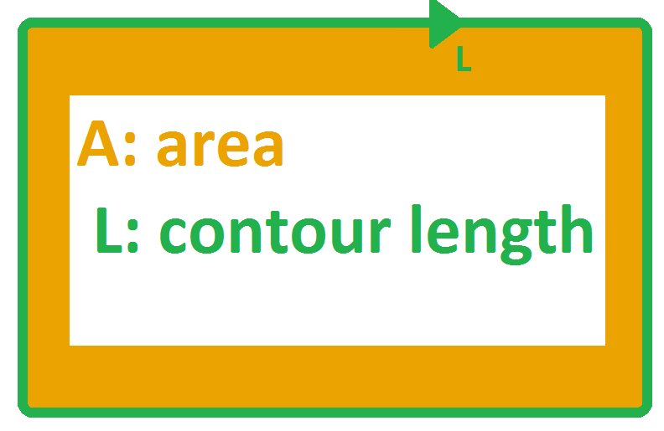
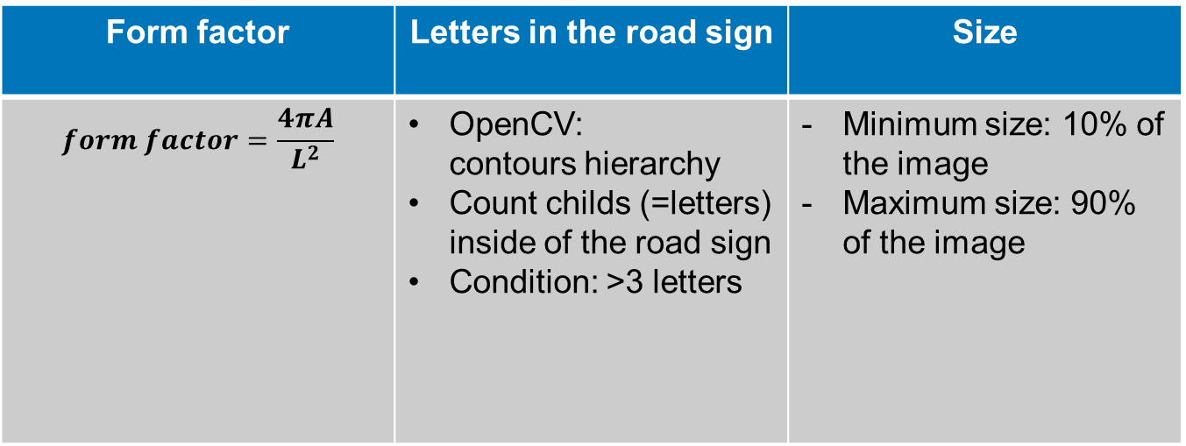
Object recognition and extraction
Recognition of the road signs define characteristics:
Form factor | Letters in the road sign | Size
$$form factor=\frac{4πA}{L^{2}}$$ | OpenCV: contours hierarchy Count childs (=letters) inside of the road sign Condition: >3 letters | Minimum size: 10% of the image Maximum size: 90% of the image
0.6 < form factor <0.8
Notes:
In order to recogine the road sign we had to define several characteristics. The first one was the form factor which describes an object by his area and contour length for an example the form factor of an circle is 1. In our chase the road sign have the shape of an rectangle so the form factor is
Between 0,6 and 0,9
The second characteristic we used, is the number of letters inside of the road sign. We calculated this amount of letters by counting the so called “childs” in the contours hierarchy of OpenCV. The text of a road sign needs to consts of minimum 3 letters.
Finally we used the size of the objects in order to classify the contous inside of our image. Objects need to occupy between of 10 and 90 percent of the total image area, in order be considerted as a road sign.

Slide 7
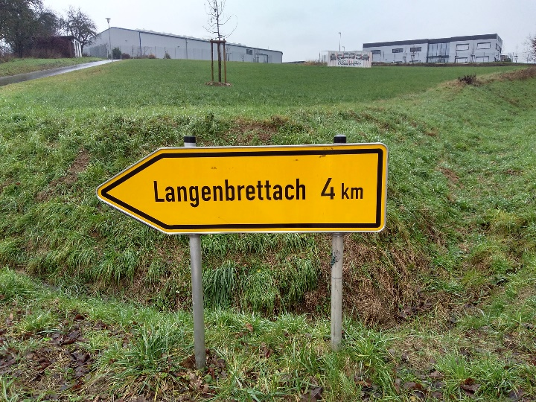


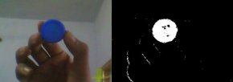
Object classification
Classification as in-town sign, sign on a country road or motorway sign
Solution: evaluate the color in the HSL color space
Example:
Evaluating for blue color shares
White pixels: true → Count
Max(white, yellow, blue)
Figure (OpenCV, no date)
Notes:
Now letzt take a look at the object classification.
Our goal was to classify all identified road signs as „in-towni“ signs, etc.
Our solution to accive that goal was to evaluate the color of the different road signs in the HSL colorspace.
HSL stands for Hue, Saturation and Luminance.
Lets give an example:
In the picture on the right side you can see a blue cap of a bottle we used that picture to find the range of the color blue in the HSL- colorspace
So the next step was to the define the range of blue, yellow and whit
We used the funciton inrange toset all pixles which are not in the range we be zero.
The result of the function inrange for the color blue can be seen also on the picture on the right side. All pixcle which where in the define range of the color blue will be retuned as white.
Then we counted the number of the white pixles to get the total number of all blue pixle in the provied road sign
We repaeate this step for yellow and white.
So in the end we would have the total number of white, yellow and blue pixls for each road sign. The function max compares the values and return the largest of all the elements.
Based on that information our programm is able to classifed the provided road sign as in-town sign, sign on a country road or motorway sign
higway

Slide 8
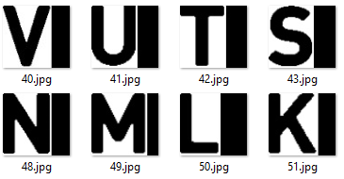



Letter recognition
Template
Database with all chars/letters is needed
extract
Online road sign generator
Adjust/
rescale
Extracted letter (DIN1451)
Fixed size (74x69 Pixel)
Flooded with 0 (black)
Notes:
The next step of your project was to recognice and classify the letters in the road sign. For that we used a methode called „compare to template“
In order to use that methode we need to create a database which contains all chars and letters we want to idenity.
Fortunately for us the font of the road sign are standarized in DIN 1451. So we used a online road sign generator in order to extract all neccsary chars and letters
Futhermore it was needed to rescale the letters on one fixed size 74x69. In our case we used the size of the largest letter in the alpahet which is w

Slide 9


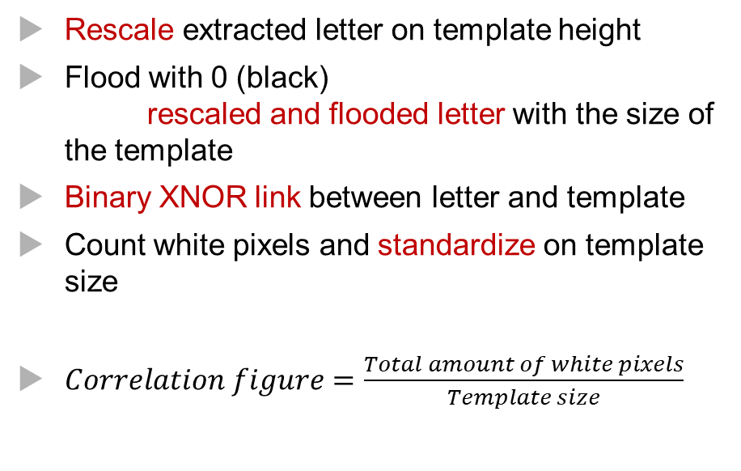
Letter recognition
Comparison between letter & template
Rescale extracted letter on template height
Flood with 0 (black) rescaled and flooded letter with the size of the template
Binary XNOR link between letter and template
Count white pixels and standardize on template size
$Correlation figure=\frac{Total amount of white pixels}{Template size}$
Figure (Onlinestreet, no date)
Extracted, rescaled and flooded letter
Template
Binary XNOR-Image
Notes:
…. In that way we compared the extracted letter with all templates. In the end the template with the highest correlation figure could be used to identify the extracted letter

Slide 10
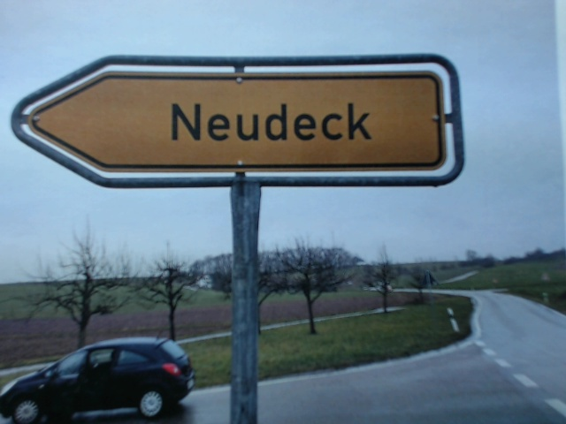
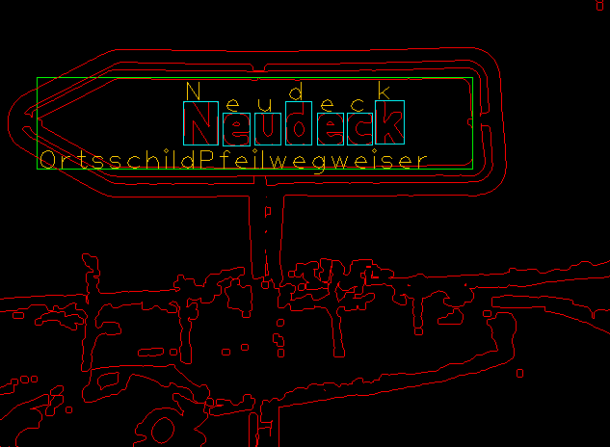
Results
Road sign recognition
Road sign classification
Letter recognition
Letter classification
Real traffic situations
Notes:
This slide shows your result. As you see we are able to extract, classify the road sign in a given picture. To get the text in the road sign in this example the text would be Neudeck.

Slide 11

Working conditions
Maximum of 90% of the total image area should be occupied by the traffic sign
The traffic sign should occupy at least 10% of the total image area
The size of the letters on the traffic sign should be at least 5x5 pixel
The traffic sign needs to be accurate
Coloured illumination is not allowed
The name of a place needs to be at least 3 characters
Figure (Rosu, no date)

Slide 12

Challenges
Complexity of C++
Hard to just try something out
Debugging in C++
Bugs in opencv (imwrite=> reduce quality)
Rotation of the image => reduce quality
(Specially for small characters)
Figure (Gumbs, 2014)

Slide 13
Thank you for your attention!
Figure (Daimler AG, no date)

Slide 14
Reference list
Daimler AG (no date) Effizienz – Intelligenter in die Zukunft. Available at: http://www.mercedes-benz.de/content/germany/mpc/mpc_germany_website/de/home_mpc/passengercars/home/new_cars/models/s-class/x222/facts/efficiency.html (Accessed: 25 December 2017).
Rosu, O. (no date) 3d people - man, person and flip chart. Checklist. Available at: https://www.123rf.com/photo_21138631_3d-people--man-person-and-flip-chart-checklist.html (Accessed: 25 December 2017).
Gumbs, Jay. (2014) 5 Challenges Faced by Affiliate. Checklist. Available at: https://amvsmlm.com/challenges (Accessed: 25 December 2017).
OpenCV (no date) OpenCV-Dokumentation - HSV-Farbraum. Available at: https://docs.opencv.org/3.1.0/df/d9d/tutorial_py_colorspaces.html. (Accessed: 25 December 2017).
Wodicka, Erwin (2002) Ausfahrt Schild auf einer Autobahn. Available at: https://www.bilderbox.com/image/Ausfahrt-Schild-auf-einer-Autobahn-101129.html. (Accessed: 25 December 2017).
Onlinestreet (no date) Ortsschild Hamburg. Available at: https://onlinestreet.de/strassen/ortsschild/Hamburg.html. (Accessed: 25 December 2017).

Slide 15
Detektionsrate: Wie oft erkennt er das Schild
Fehler erster Art: Ein Buchstabe wird falsch erkannt
Fehler zweiter Art: Er erkennt das Schild nicht
Fragen:
Warum funktioniert die Binarisierung mit Otsu bei manchen Schildern besser?
-Warum rotation?
Warum wird die Qualität durch imread schlechter obhol bei 100%?

